Slide 1


FYP
Spot Finder (Smart Parking Reservation System)
Lazba (2391-2021)
M. Ali Sheikh (2423-2021)
Rahema Waseem (2444-2021)
Supervisor
Mr. Faheem Ahmed
Department of Computing, FEST
Hamdard University

Slide 2
Summary
Problem Statement
Objective
FYP Scope
Our methodology
Our Project Plan (Time lines)
Budget / Costing (if any)
FYP Deliverables

Slide 3
Summary
Literature Review
Demo of 100% of Work
Experimental Evaluations & Results
Test Plan & Test Cases
References

Slide 4
Problem Statement
PROBLEMS:
Scarcity of parking spaces in places like shopping malls, hotels, and cinemas.
Wasted time searching for empty parking spots as well as unbearable frustration for drivers.
Finding a parking space; leads to frustration and, to the worst-case scenario, stress among drivers.
Drivers circling around parking lots cause disorder and tension on the roads.

Slide 5
Problem Statement
SOLUTION:
Establish a digital system that controls parking.
Automate the process of parking to lessen human intervention.
Optimize parking space use.
Real-time updates on available spots through the app.
Speed up the process of parking, thus reducing search duration.
Continue the simplification process, minimizing wasted time, and making the parking experience better.

Slide 6
Objective
Enhance User Interface:Streamline the search and booking process of parking spots
Real-time information for a seamless parking experience
Automate Parking Operations
Minimal human intervention in parking and unparking
Using sensors and path tracing technology, guide cars to free spaces

Slide 7
Objective
Save time and efforts of drivers
Efficient System Administration
Provide an Admin Dashboard with advanced management tools
Provide price settings and occupancy tracking of parking spaces.

Slide 8
FYP Scope
Assists motorists by indicating and reserving parking spaces via a mobile application.
Features a centralized database to store parking information.
Includes a secure payment gateway for seamless transactions.
Provides parking lot operators with tools to manage availability and access analytics.
Uses real-time data to identify the best available parking slot automatically.
Aims to enhance parking efficiency, reduce search time, and simplify the parking experience.

Slide 9
Our Methodology
We apply PROTOTYPE METHODOLOGY to quickly iterate on user requirements and system functionality for our automated parking system. Through the construction and iteration of throwaway prototypes, we validate features such as seamless parking reservations and efficient management dashboards early in development. This minimizes manual intervention and ensures that the final system meets user needs effectively while addressing issues such as time-consuming parking searches and wasted fuel.

Slide 10
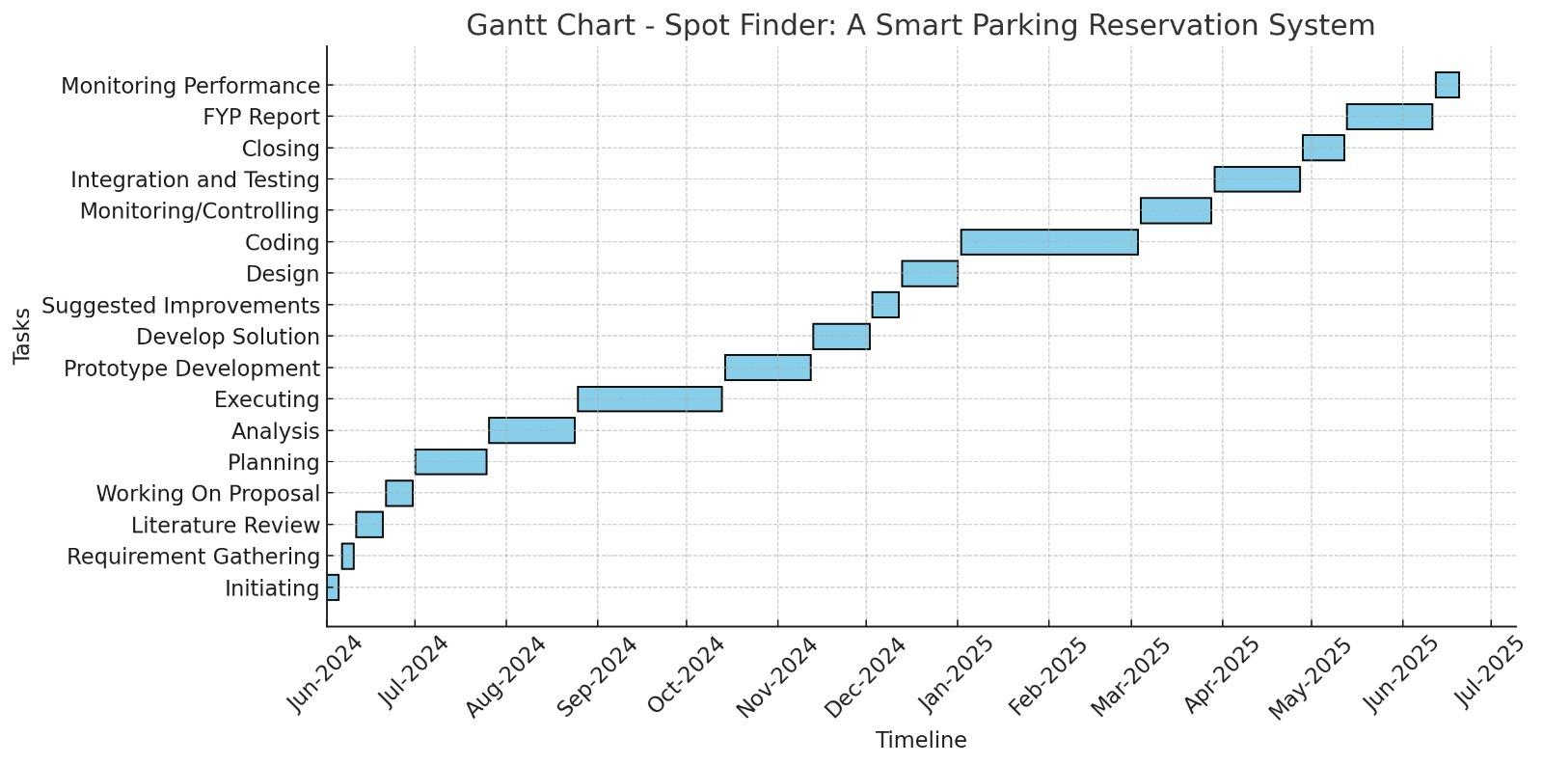
Our Project Plan

Slide 11
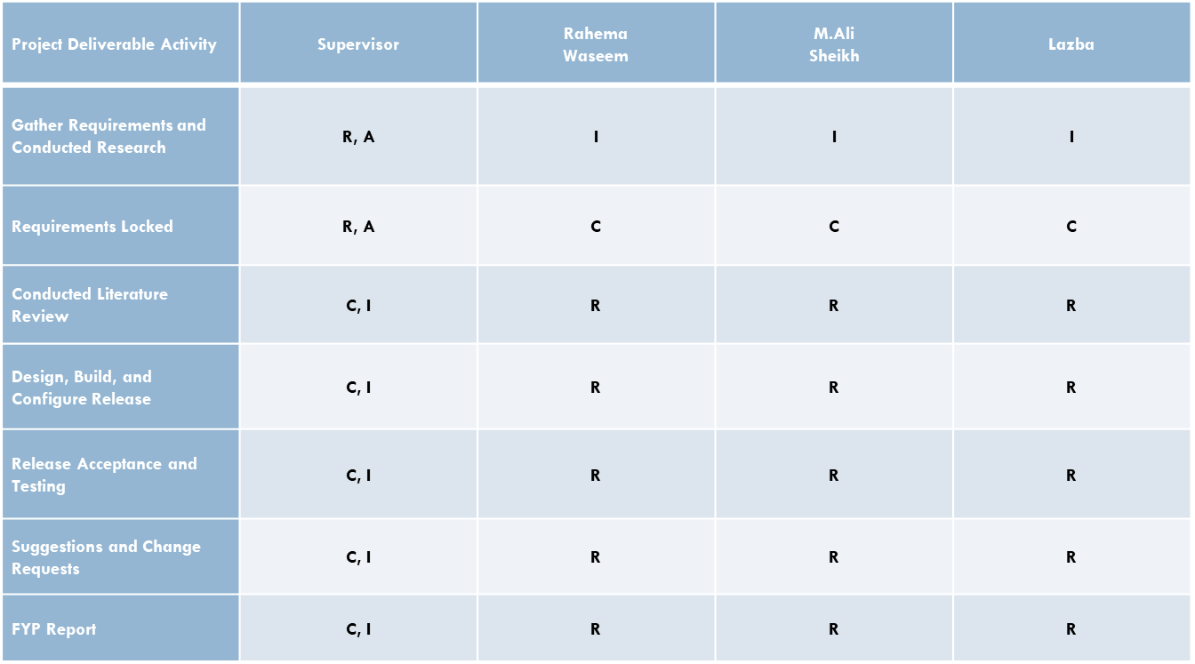
Our Project Plan

Slide 12
Budget / Costing
S No | Product Name | Price*
1 | Raspberry Pi Camera Module 2 | 13,000
2 | Raspberry Pi 4 Model B 8GB | 36,000
3 | Ultrasonic Sensors | 11,500
4 | Ambient LED Lights | 7,000
5 | Laptop | 50,000
6 | Mobile | 26,000
7 | Developer | 180,000
8 | Miscellaneous expenses | 10,000
 | Total | 333,500

Slide 13
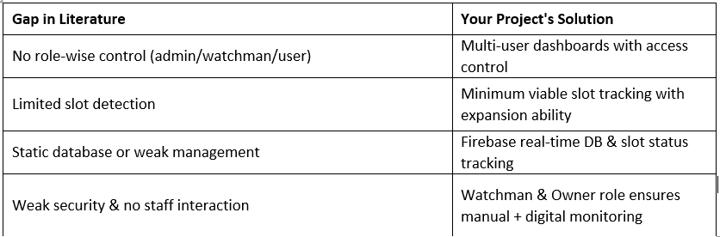
Literature Review

Slide 14
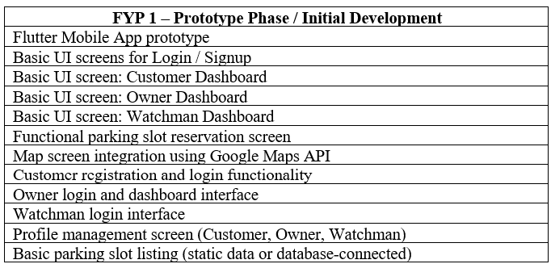
FYP Deliverables

Slide 15
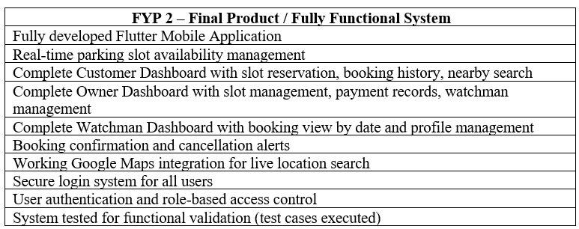
FYP Deliverables

Slide 16
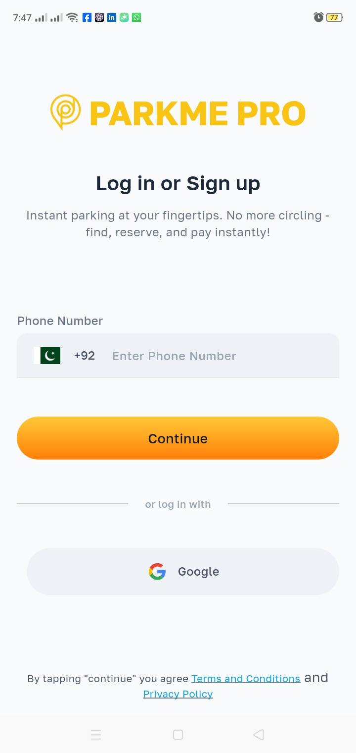
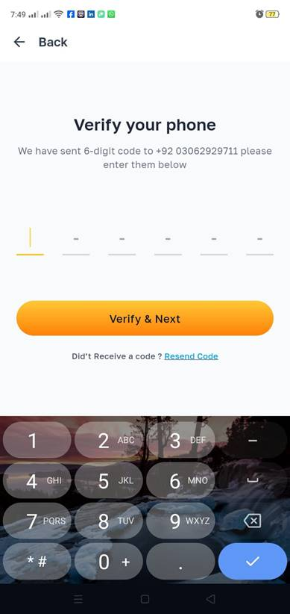
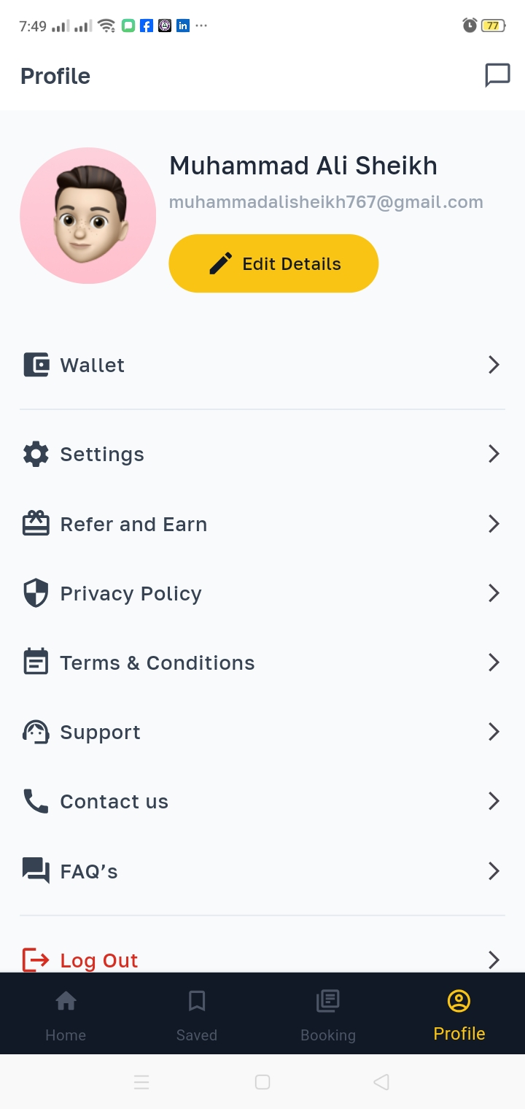
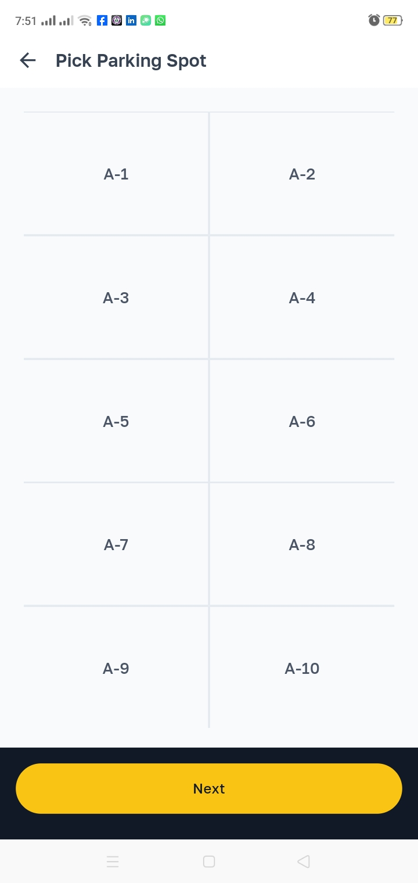
Demo of 100% of Work (Customer)

Slide 17
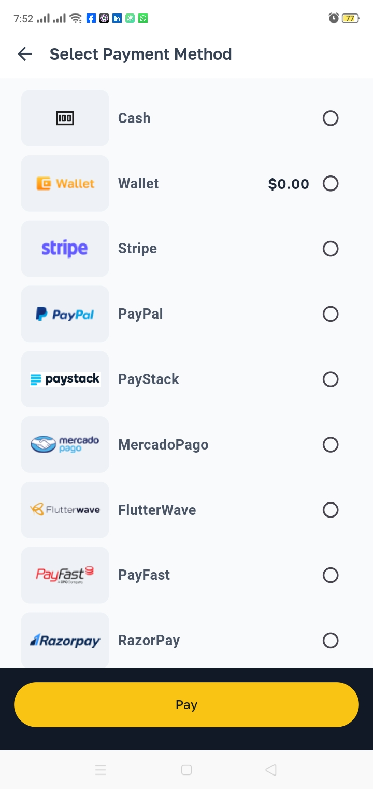
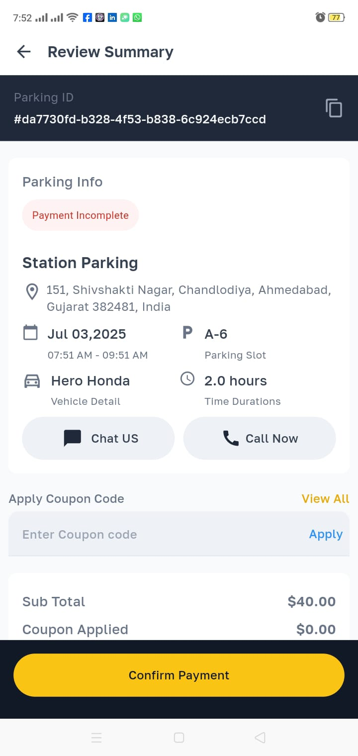
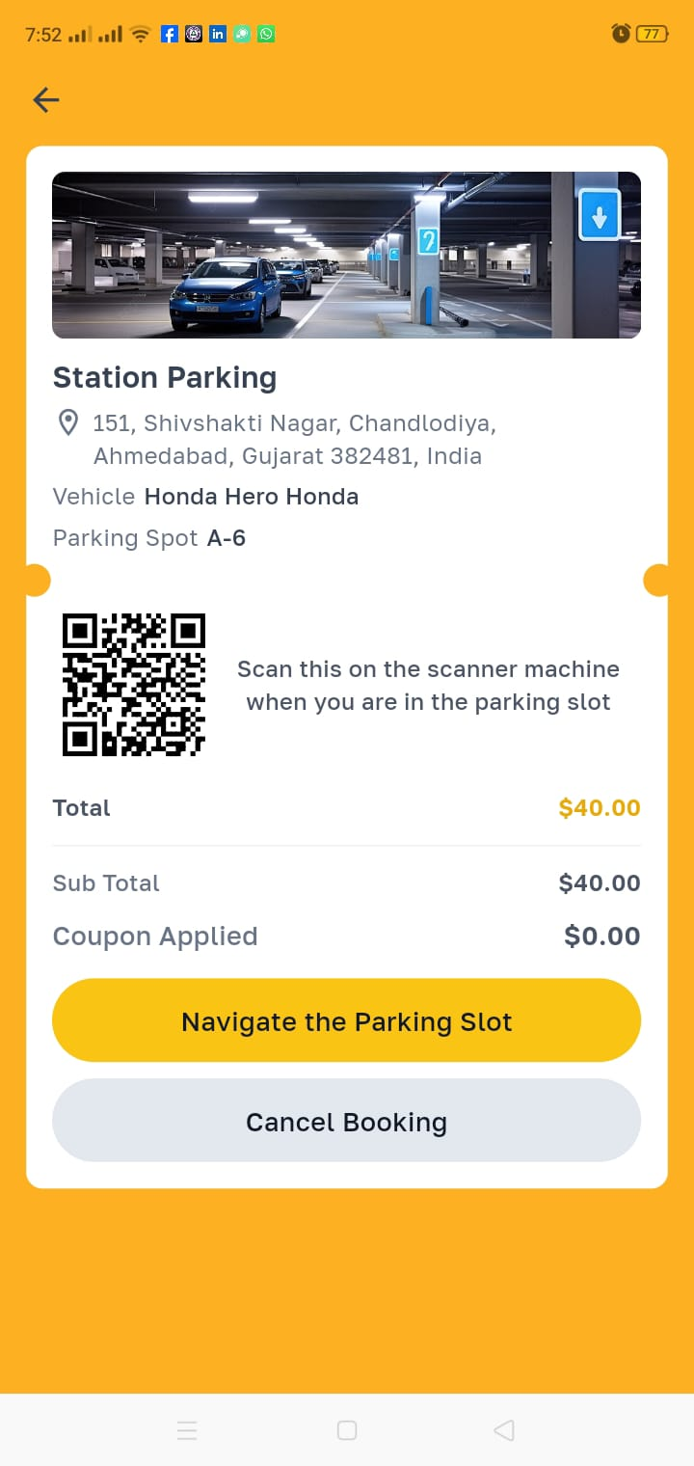
Demo of 100% of Work (Customer)

Slide 18
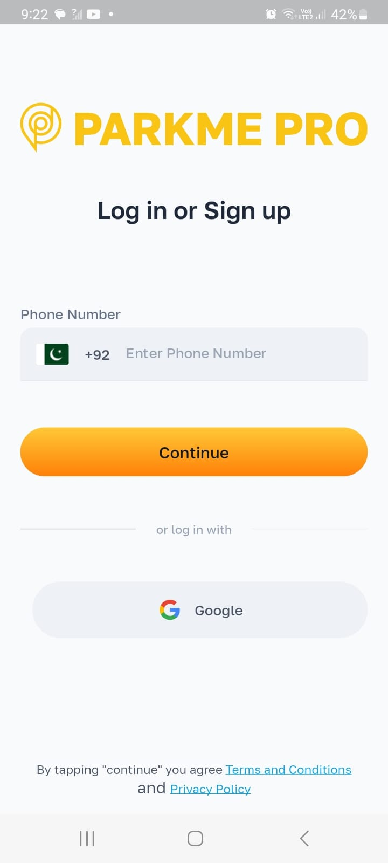
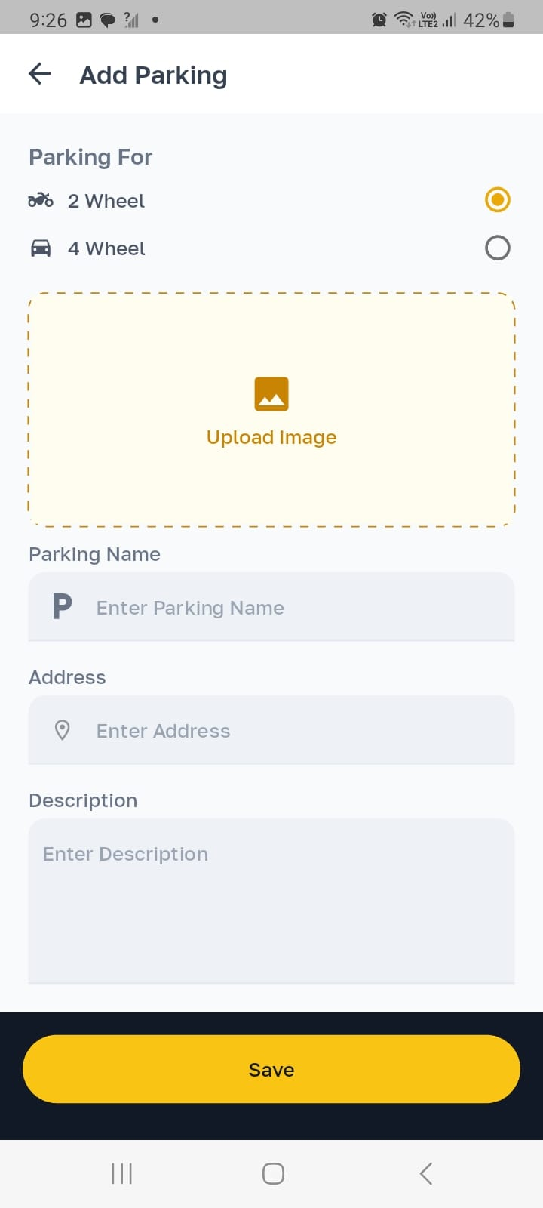
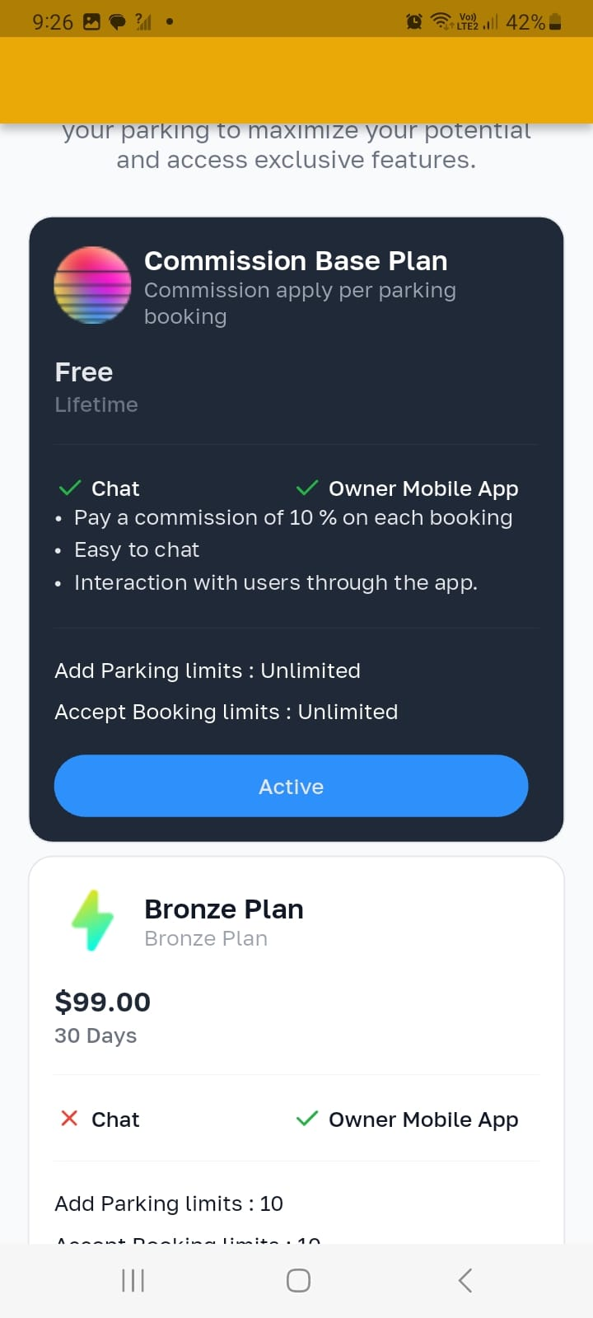
Demo of 100% of Work (Owner)

Slide 19
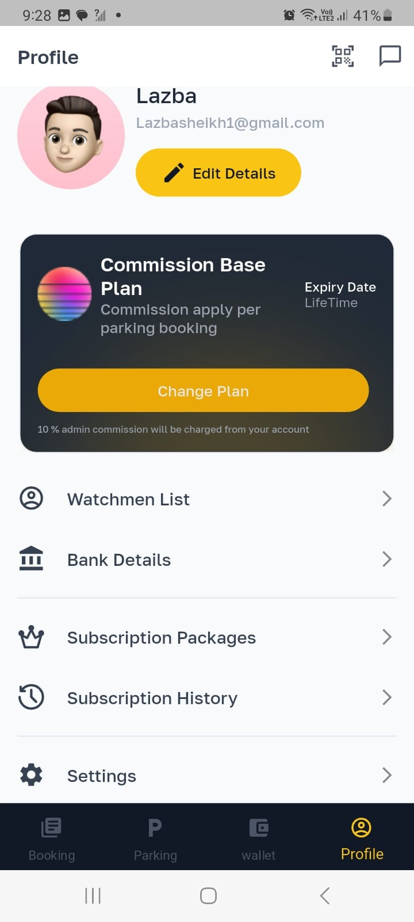
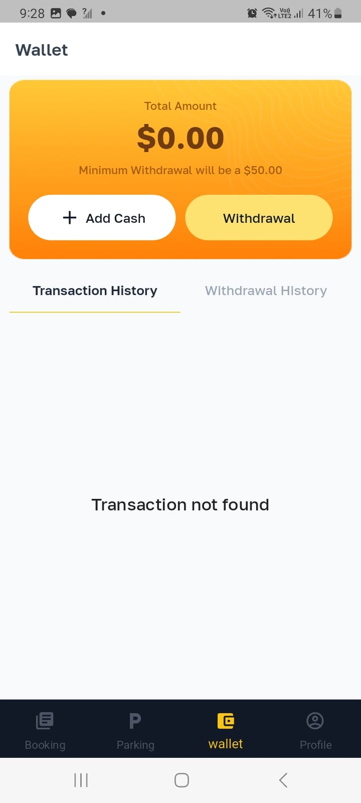
Demo of 100% of Work (Owner)

Slide 20
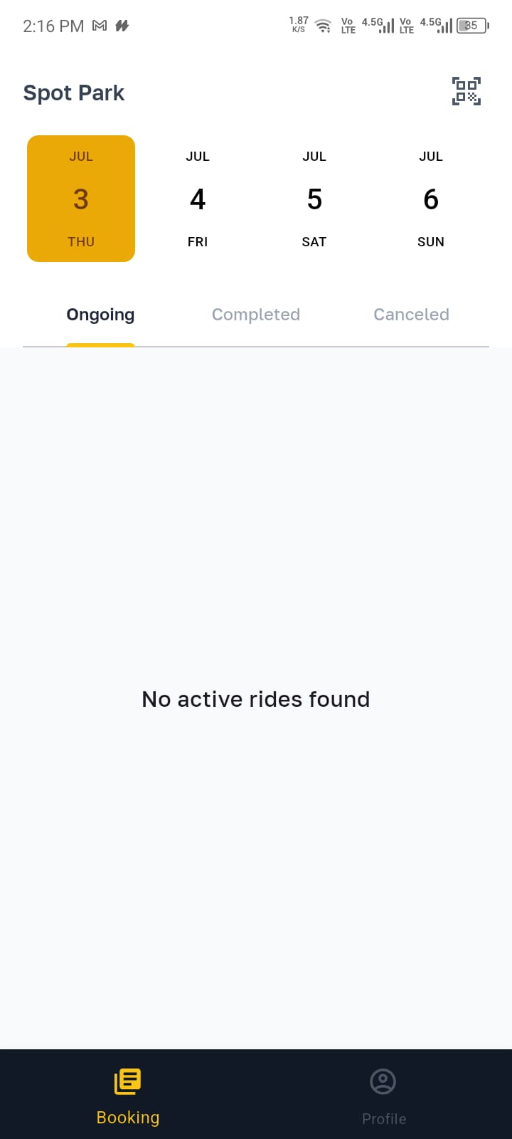

Demo of 100% of Work(Watchman)

Slide 21
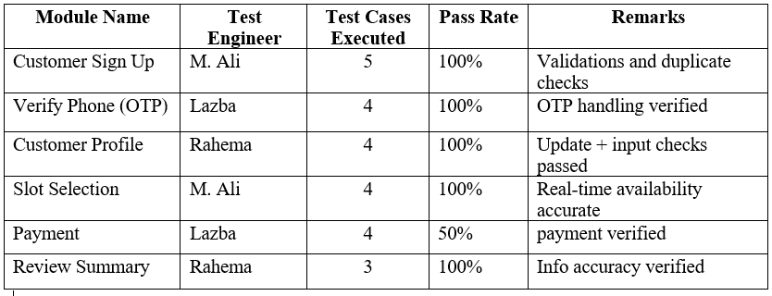
Experimental Evaluations & Results

Slide 22
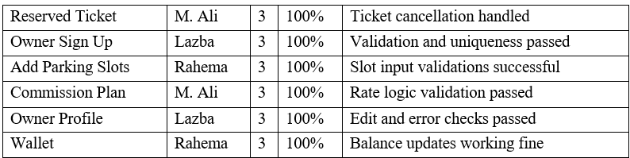
Experimental Evaluations & Results

Slide 23
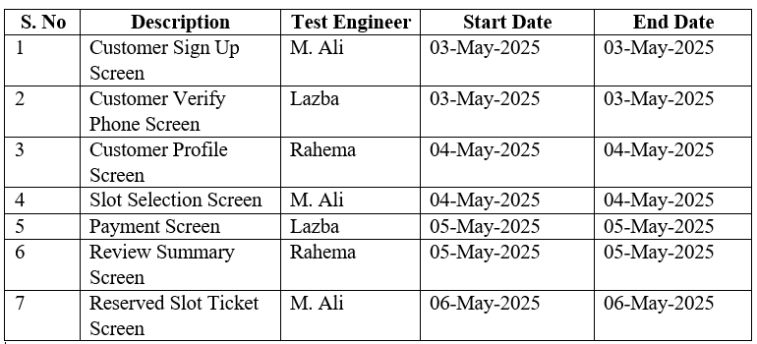
Test Plan & Test Cases

Slide 24
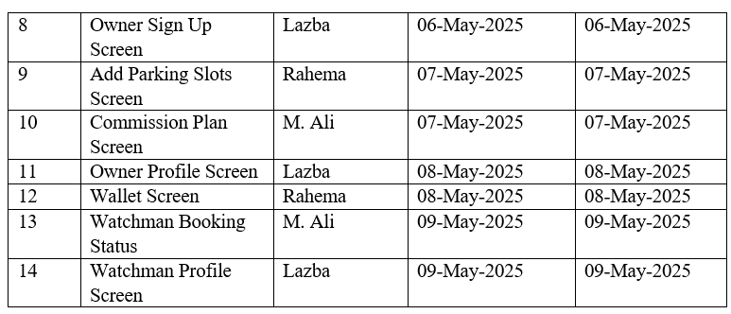
Test Plan & Test Cases

Slide 25
Reference
1. A. Somani, S. Periwal, K. Patel, and P. Gaikwad, “Cross Platform Smart Reservation
Based Parking System,” in 2018 International Conference on Smart City and
Emerging Technology (ICSCET), IEEE, Jan. 2018, pp. 1–5. doi: 10.1109/ICSCET.2018.8537282.
2. P. Sheelarani, S. P. Anand, S. Shamili, and K. Sruthi, “Effective car parking reservation system based on internet of things technologies,” in 2016 World Conference on Futuristic Trends in Research and Innovation for Social Welfare (Startup Conclave), IEEE, Feb. 2016, pp. 1–4. doi: 10.1109/STARTUP.2016.7583962.
3. W. A. Jabbar, C. W. Wei, N. A. A. M. Azmi, and N. A. Haironnazli, “An IoT
Raspberry Pi-based parking management system for smart campus,” Internet of Things, vol. 14, p. 100387, Jun. 2021, doi: 10.1016/j.iot.2021.100387.

